Slide 1
Testing Communities
By Jack Bartley
Notes:
Hello, my name is Jack Bartley, and today in going to be discussing Testing communities from section 9.6 of the textbook.

Slide 2
Overview
What Are Communities
Community Detection Algorithms
Girvan-Newman Benchmark
Lancichinetti-Fortunato-Radicchi Benchmark
Measuring Accuracy
Algorithmic Speed
Notes:
Over the course of this presentation I will be going over what are communities, what algorithms do we use to find these communities, the two benchmarks which we test these algorithms against, as well as how we determine which algorithm to use based on its accuracy and speed.

Slide 3
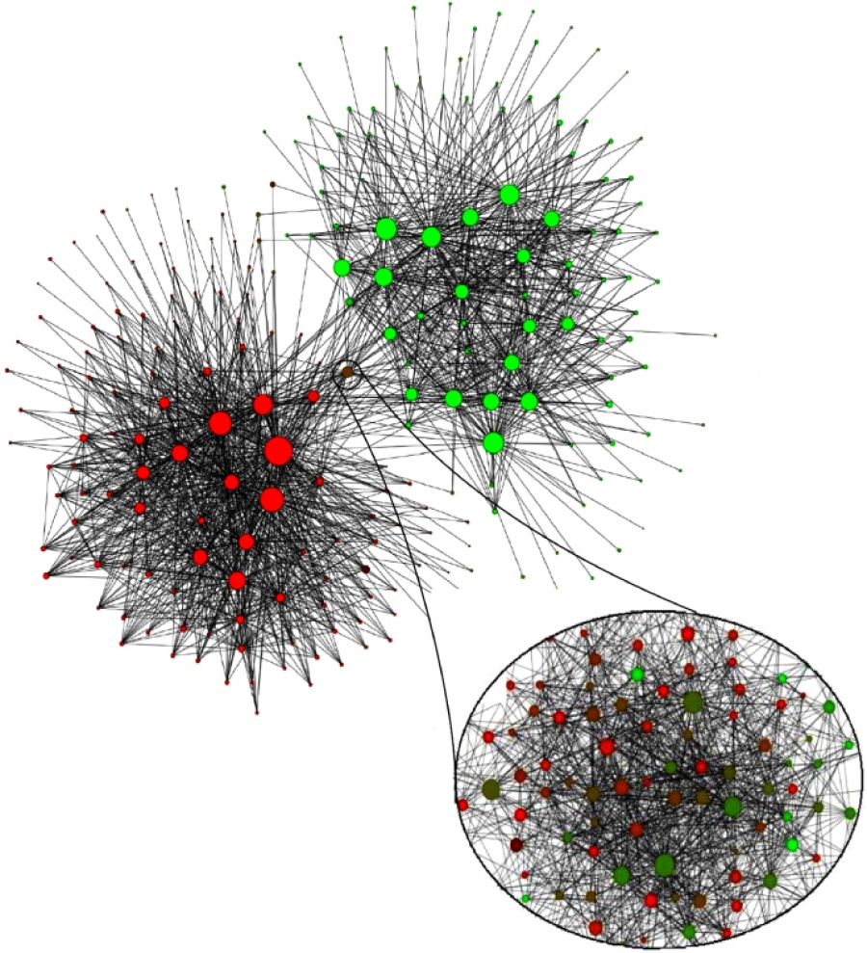
What Are Communities?
Communities are groups of nodes within a network that are more likely to connect with each other than nodes from different communities.
We define these communities as locally dense connected subgraph in a network
In order to find communities within a network we use community detection, which in its simplest form takes all possible network partitions, and allows us to select the partition which best fits our definition of a community
Notes:
Lets start with a simple question, what are communities?
Communities are groups of nodes within a network that are more likely to connect with each other than nodes from different communities.
For example here is an image of a belgian social network, where we can see 2 distinct communities, the red nodes representing the french speaking population of belgium, and the green the dutch. For both the green and red communities we can see a high degree of connectivity, as well as only a small group of nodes which connect both communities.
More officially communities are defined as locally dense connected subgraphs within a network.
So how do we decide which nodes belong to which community? For this we do use community detection which finds a graph partiton that breaks the network into groups that best fit our definition of a community

Slide 4
Community detection algorithms
For large networks the computational cost of checking all possible partitions is incredibly inefficient, so we use algorithms to make community detection possible
Hierarchical Clustering: A similarity matrix whose elements indicate the distance between two nodes.
Agglomerative algorithms: merge nodes with high similarity into one community
Divisive algorithms: remove low similarity links that connect communities
Modularity :Compares the expected number of links between nodes of a random and real network
Greedy modularity:Joins pairs of communities if it increases the partitions modularity
Louvain: Optimizes modularity for small communities, then aggregates them and repeats
Clique Percolation: Finds all cliques, then checks the clustering of those cliques to see if they belong in the same community
Link Clustering:Creates a similarity link similarity matrix based on the neighborhood of nodes connected to those links, and then applies Hierarchical clustering algorithms to merge communities

Slide 5
Which Algorithm Should we use
Given a network that does not have a uniquely encoded community structure, which algorithm works best for community detection?
Different algorithms utilize different network properties to predict communities, and therefore will not always give the same or the completely correct answer.
To determine which will give the best prediction, we assess their accuracy by comparing their predictions to two benchmarks
Girvan-Newman Benchmark
Lancichinetti-Fortunato-Radicchi Benchmark

Slide 6
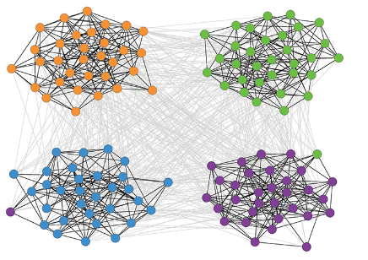
Girvan-Newman Benchmark
The Girvan-Newman(GN) Benchmark is a network with a predefined correct community structure
N= 128 nodes
n_{c}= 4 communities of size 32
P_{int} probability of connecting to nodes within its community
P_{ext} probability of connecting to nodes outside of its community

Slide 7
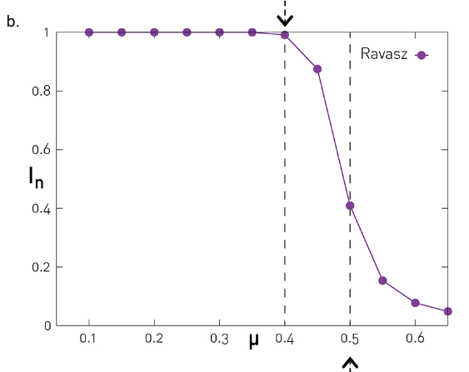
Testing the Girvan -Newman Benchmark
When using the GN benchmark, the μ is equivalent to the link density difference between communities
As μ increases the accuracy of algorithms decreases
We quantify this accuracy as the normalized mutual information between the 4 defined communities, and the partition given by the algorithm I_{n}
For most algorithms this drop comes sharpley after μ = 0.4

Slide 8
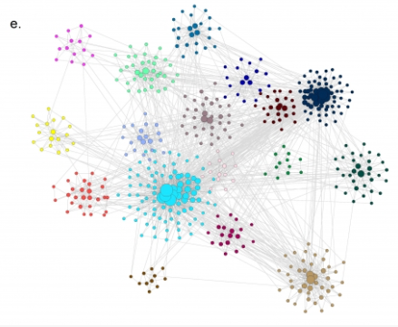
Lancichinetti-Fortunato-Radicchi Benchmark
The Lancichinetti-Fortunato-Radicchi(LFR) Benchmark aims to be a more realistic network where node degrees and community sizes follow power laws
Given N isolated nodes assign each to a community size N_{c}
N_{c}= PNc~Nc-ζ
Each node i has a degree ki =p_{k}~k^{-γ}
Internal degree of i = (1-μ)k_{i} with remaining links being external

Slide 9
Measuring Accuracy
In order to calculate I_{n} for different algorithms in relation to to a benchmark we need an equation to compare the community structures’ normalized mutual information
For both network partitions, consider a distribution p(C) where p is the probability that a randomly selected node in a network belongs to community c
Given 2 networks and two probability distributions p(C₁) and p(C₂), you can make a new probability distribution p(C₁, C₂) where p is the probability that a node is in community C₁ in one partition and C₂ in the other.
We then can find the normalized mutual information using

Slide 10
Measuring Accuracy
Using the equation I_{n} we see that the normalized mutual information (accuracy) of the partition is 0 when C1 and C2 are completely independent of each other
We can also find the maximum value of H when C1 and C2 are identical, i.e. H({p(C1)}) = H({p(C2)}), amd we can get that value using the Shannon Entropy equation

Slide 11
Testing Algorithms
Using our normalized mutual information equation we can now check all the community detection algorithms against both benchmarks
From this we see that while most algorithms keep the same efficiency until the μ =0.4 drop off on the NG benchmark, when tested against the more realistic LFR benchmark, greedy is shown to have a completely different rate of change than the other algorithms, while the Louvain and Ravasz algorithms work even better than they did in the NG Benchmark

Slide 12
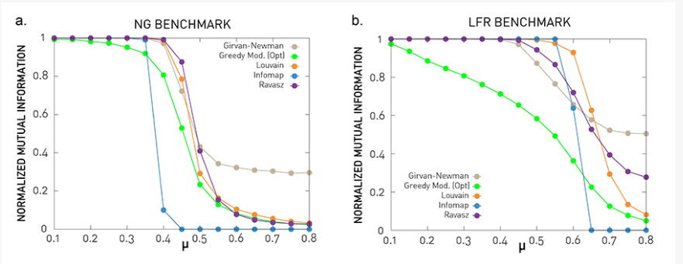

Slide 13
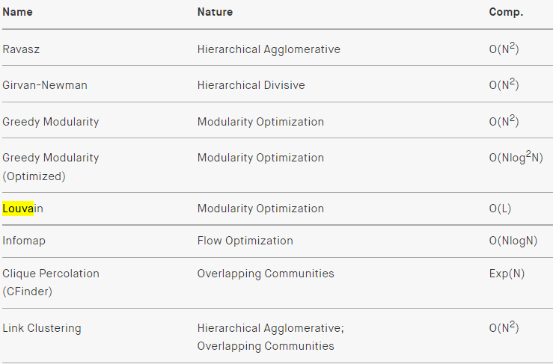
Algorithm Speed
The other thing you need to consider when choosing an algorithm besides its accuracy, is the time complexity, and computational cost to run the algorithm
Below we can see that Louvain and Infomap algorithms are the most efficient, while Cfinder is the least efficient

Slide 14
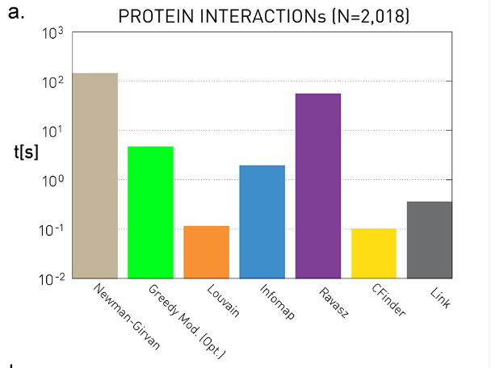
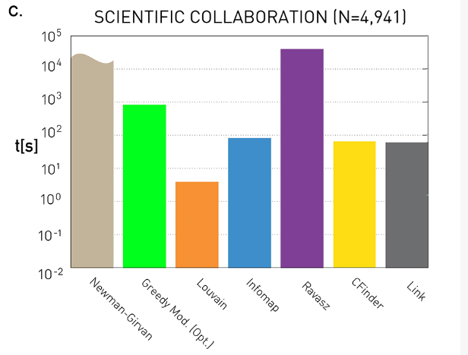
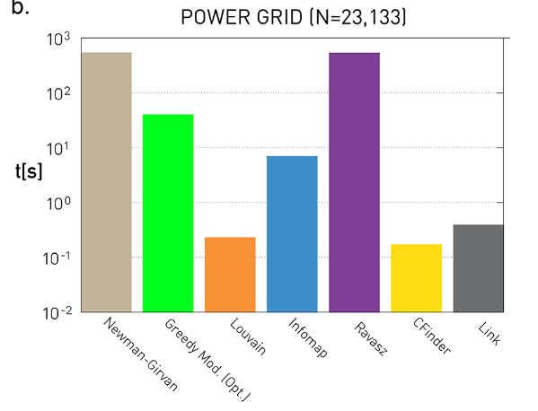
Algorithm Speed
Using the computational complexity, we how the algorithm run time will scale with N, but not the actual run time of the algorithm
As a result, depending on the size of the network some more complex algorithms can actually be just as, even more time efficient

Slide 15
References
Barabási Albert-László. Network Science. Cambridge University Press, 2016.
Blondel, Vincent. Louvain Method for Community Detection. Mar. 2011, https://perso.uclouvain.be/vincent.blondel/research/louvain.html.
Jayawickrama, Thamindu Dilshan. “Community Detection Algorithms. Many of You Are Familiar with Networks… | by Thamindu Dilshan Jayawickrama | Towards Data Science.” Medium, Towards Data Science, 29 Jan. 2021, https://towardsdatascience.com/community-detection-algorithms-9bd8951e7dae.

